Slide 1
Advanced Database Management Systems (CSC-234)
MongoDB Queries

Slide 2
Finding with expressions & comparison queries

Slide 3
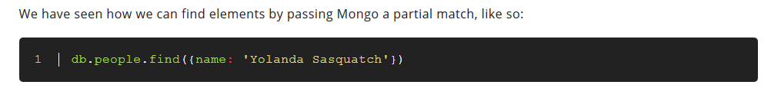

Slide 4
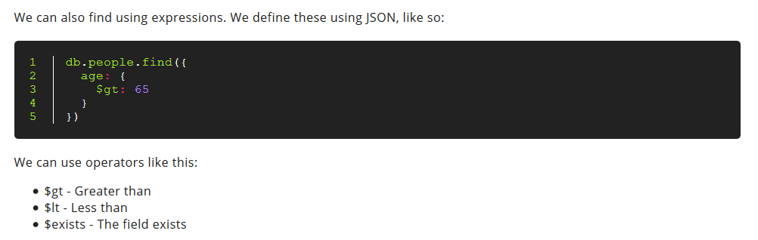

Slide 5
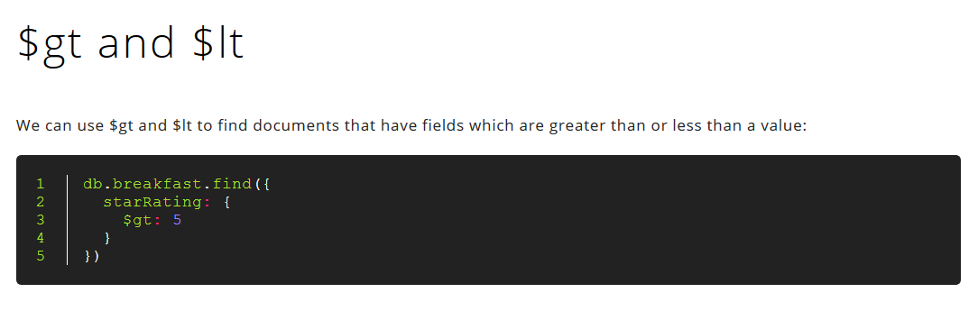

Slide 6
Refer to manual for complete list
https://docs.mongodb.com/manual/reference/operator/query/

Slide 7
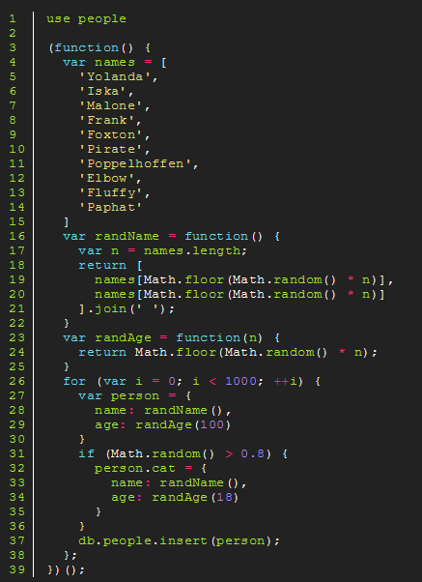
Practice Exercise
Copy the following code into a Mongo terminal. It will create a collection of people, some of whom will have cats.
Optionally modify the code so that some people have piranhas, and some have dachshunds.
http://nicholasjohnson.com/mongo/course/workbook/

Slide 8
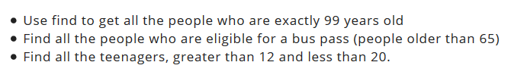
Practice Exercise

Slide 9
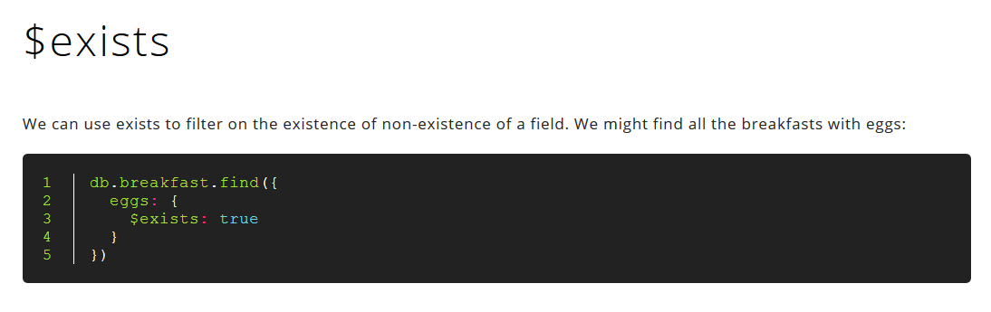

Slide 10
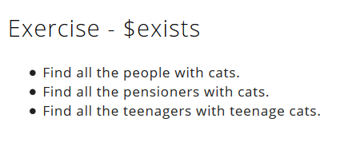

Slide 11
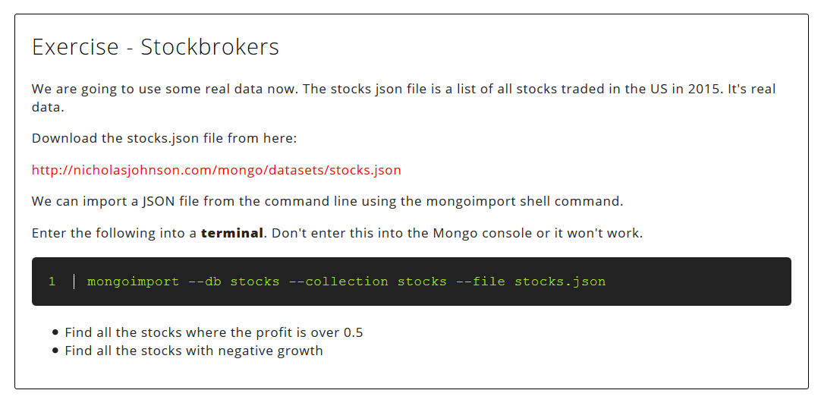

Slide 12
Load json file into atlas using console (mongoimport) or compass
https://docs.atlas.mongodb.com/import/mongoimport/

Slide 13
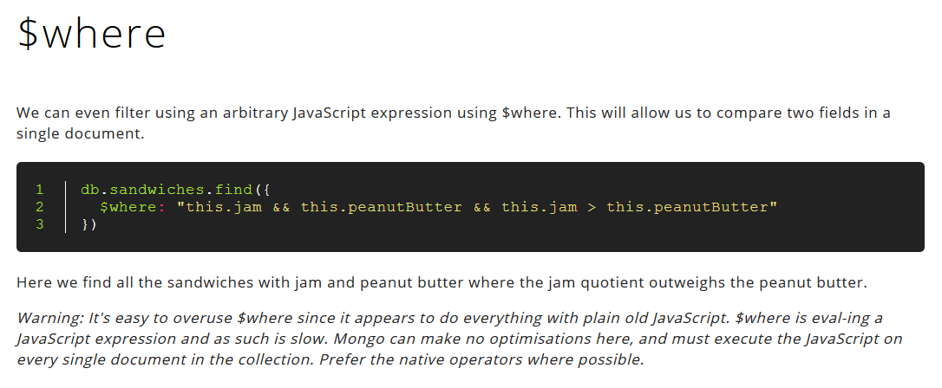

Slide 14
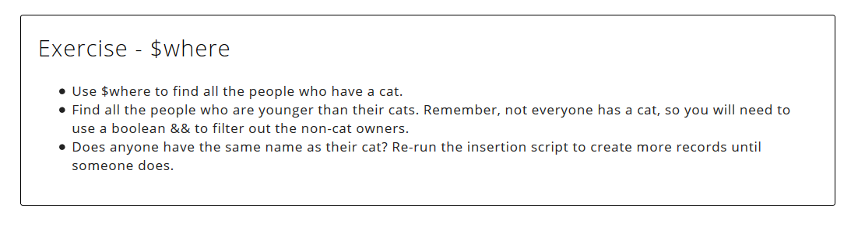
On people db (created via script earlier)

Slide 15
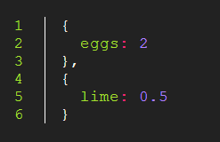
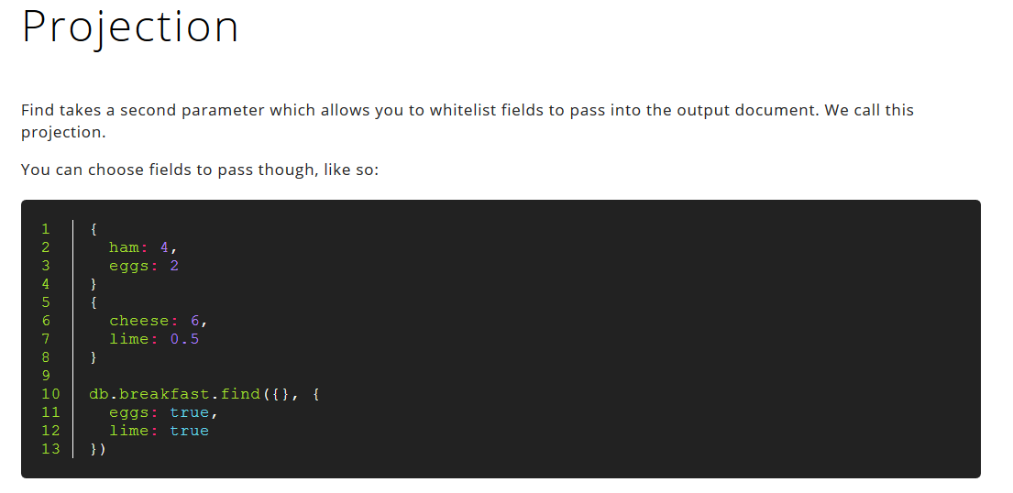

Slide 16
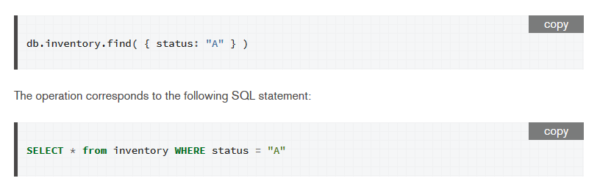
SQL Comparison (Find)

Slide 17
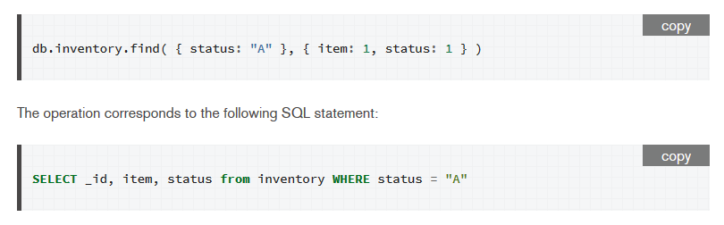
SQL Comparison (Projection)

Slide 18
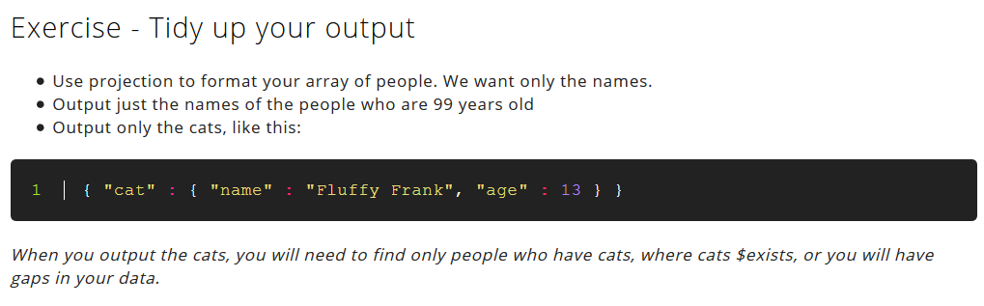

Slide 19
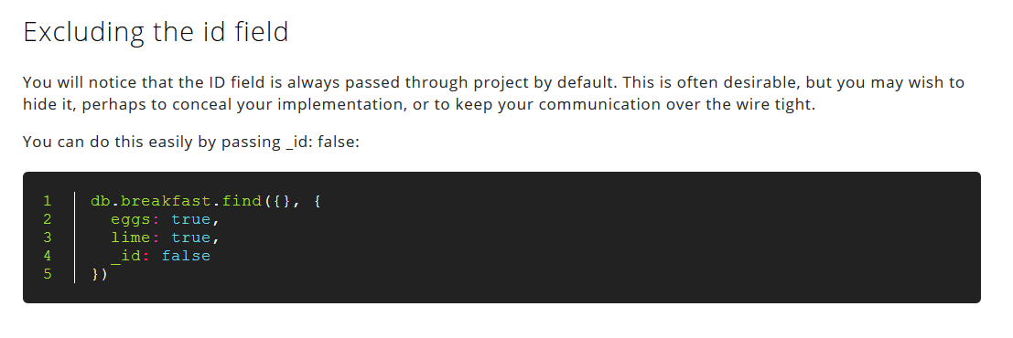
ID is shown by default

Slide 20
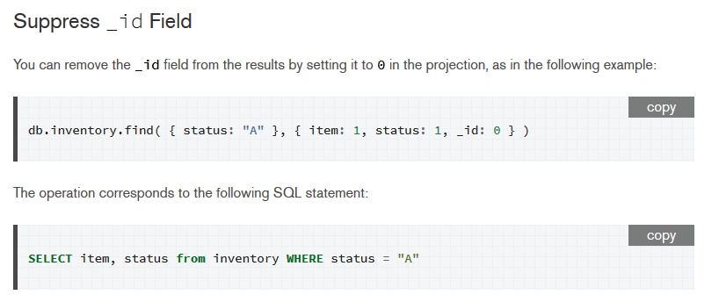
SQL Comparison

Slide 21
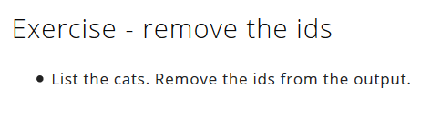

Slide 22
More on projection
https://docs.mongodb.com/manual/tutorial/project-fields-from-query-results/

Slide 23
Count, limit, skip & sort

Slide 24
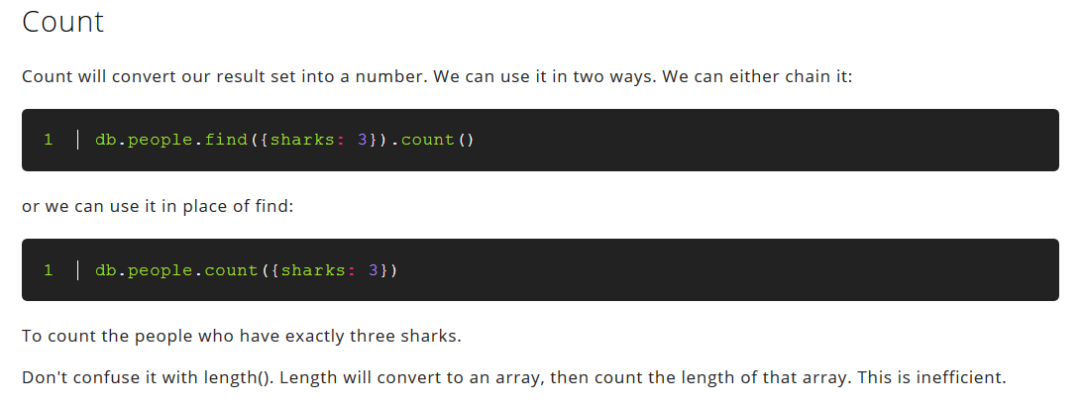

Slide 25
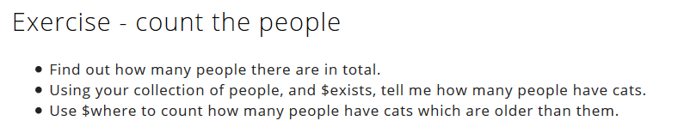

Slide 26
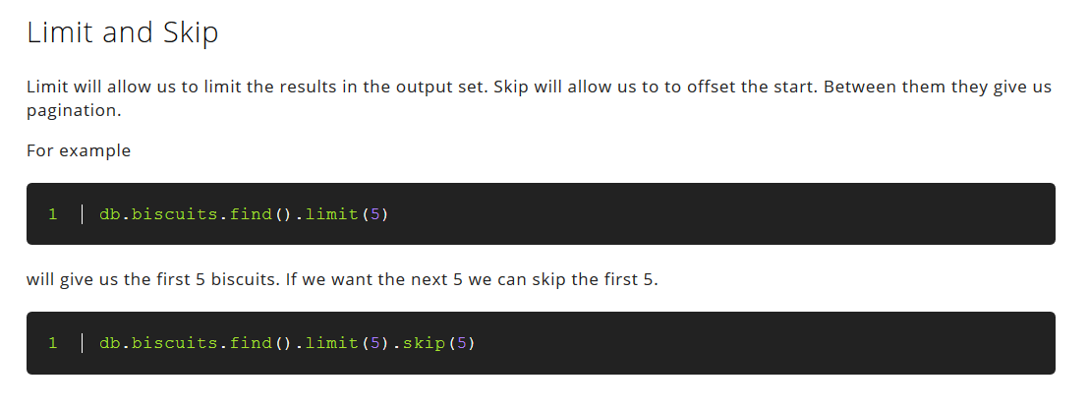

Slide 27
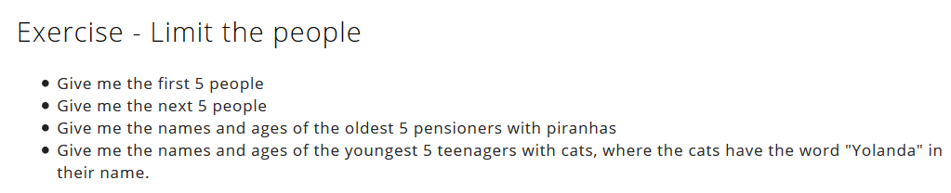

Slide 28
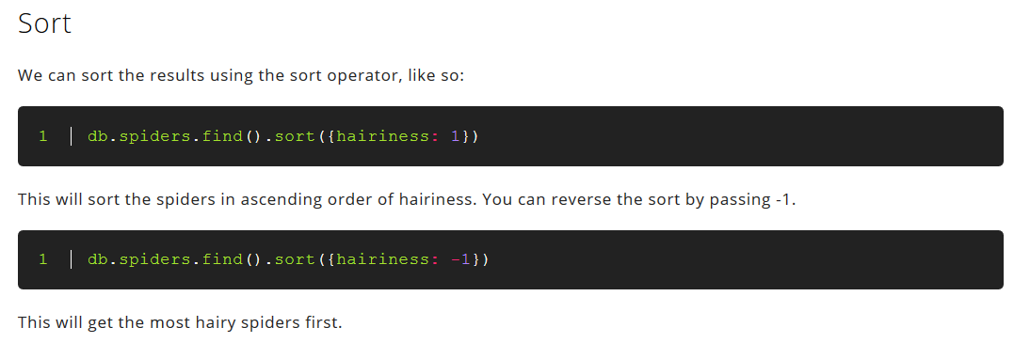

Slide 29
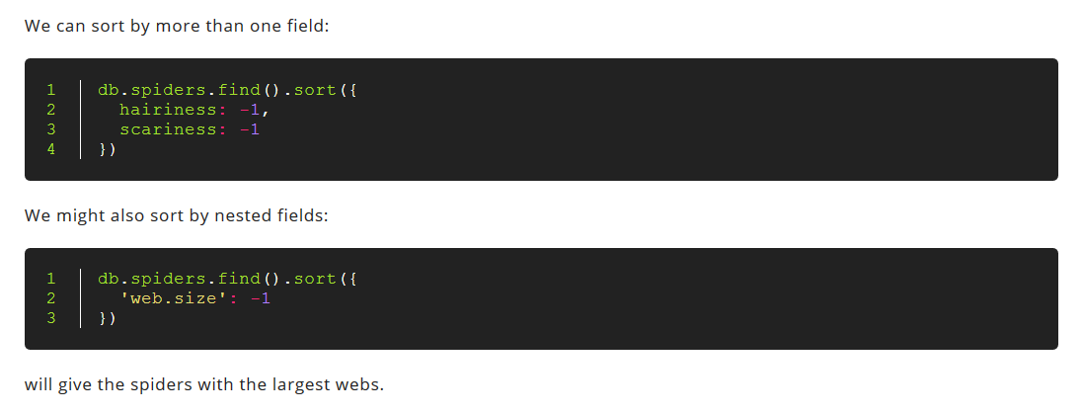

Slide 30
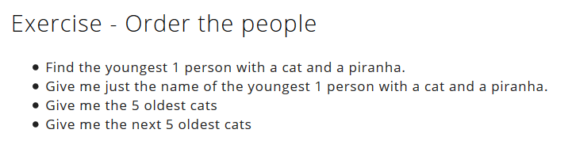

Slide 31
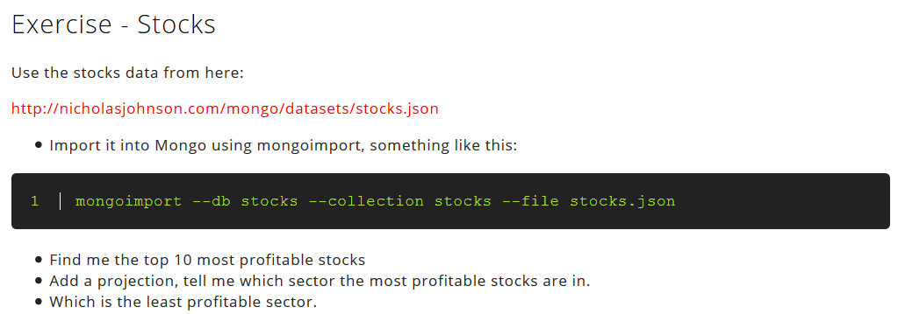

Slide 32
Lecture content adapted from https://docs.mongodb.com/manual/ & http://nicholasjohnson.com/mongo/course/workbook/

